Slide 1
Foundations Archaeology
in association with
Purton Historical Society
THE ROMANS IN PURTON PROJECT
Introduction Presentation
Wednesday 24th April

Slide 2
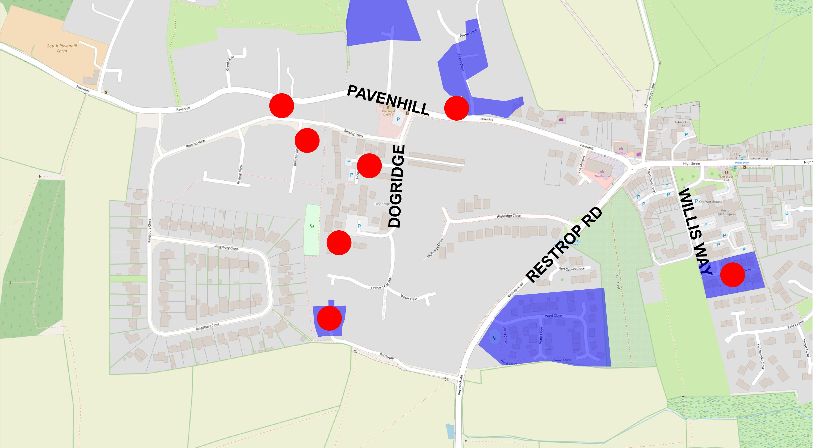
MOSAIC
POTTERY KILNS
BUILDING,
CEMETERY
BUILDINGS, KILNS,
BURIAL

Slide 3
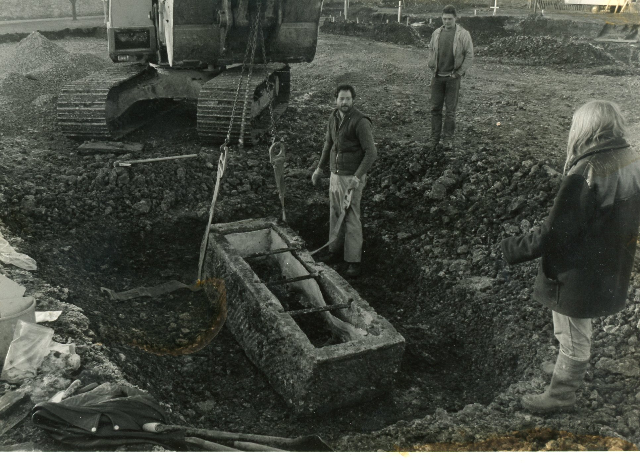

Slide 4
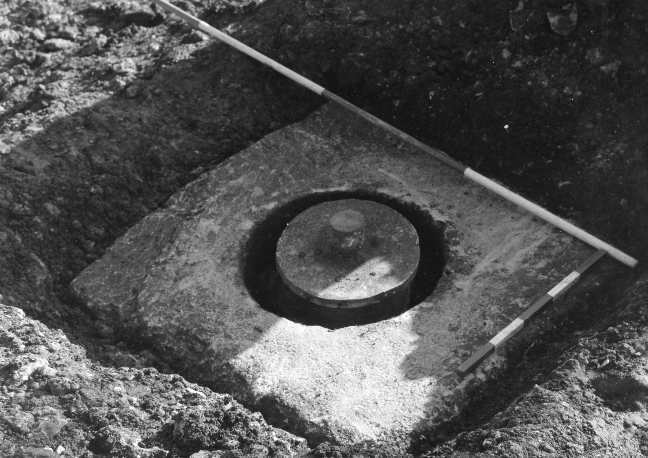

Slide 5
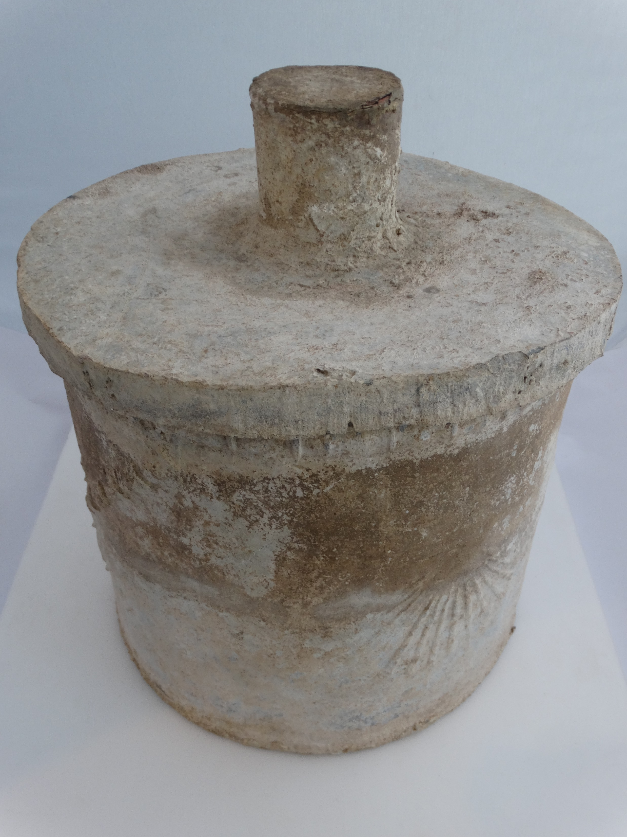
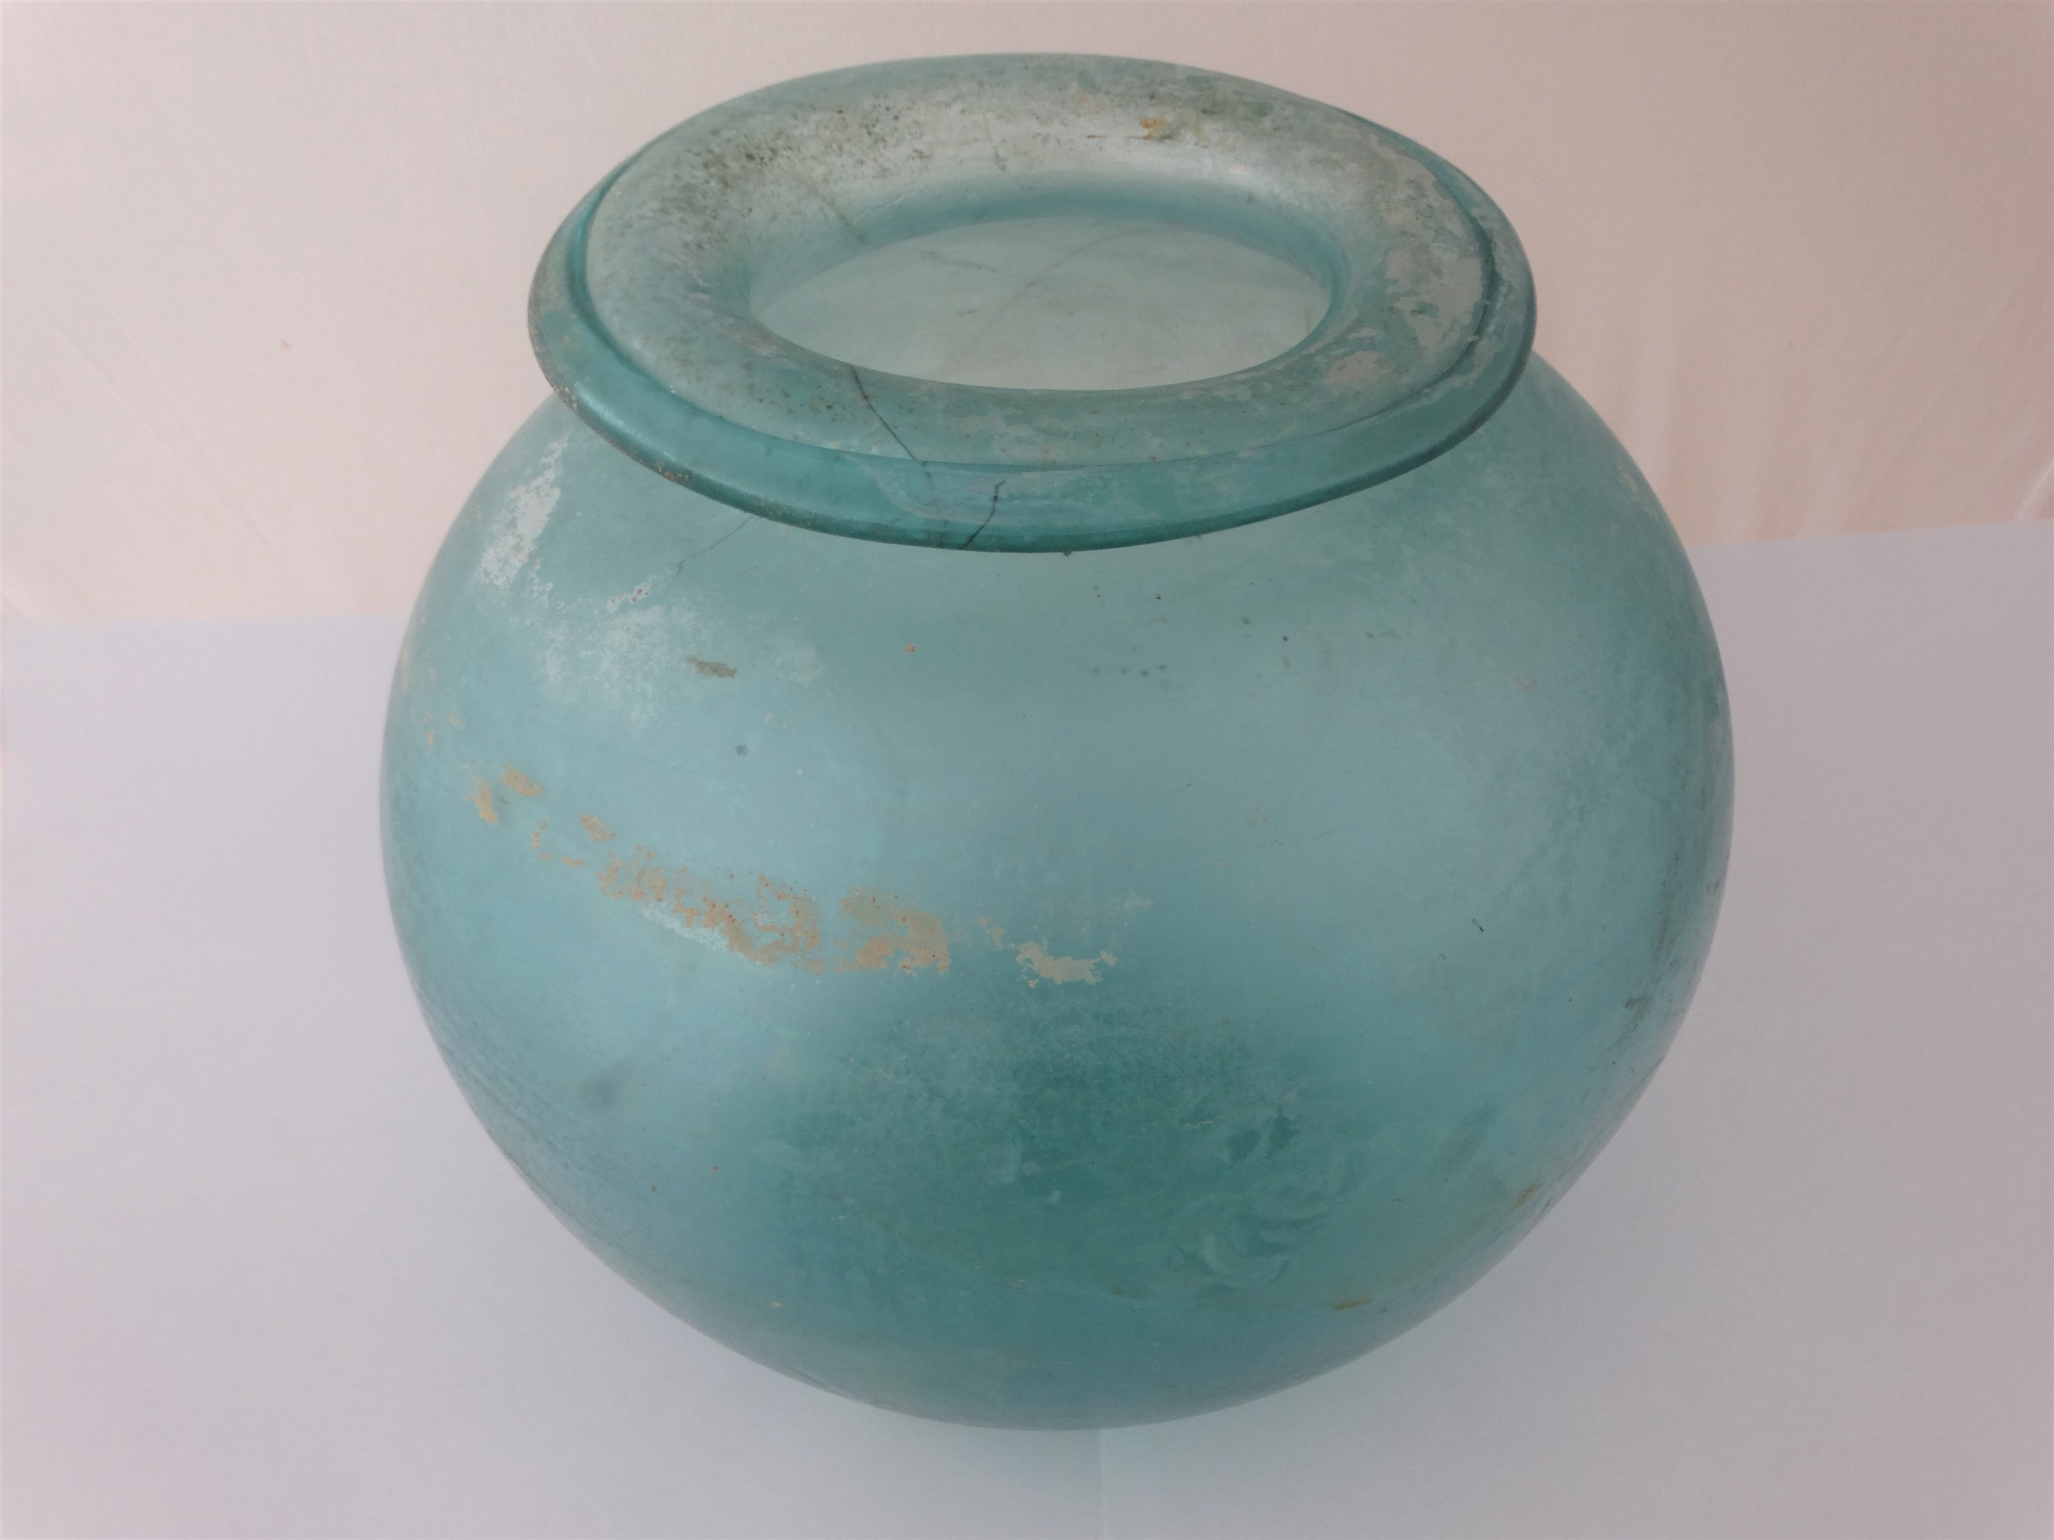

Slide 6
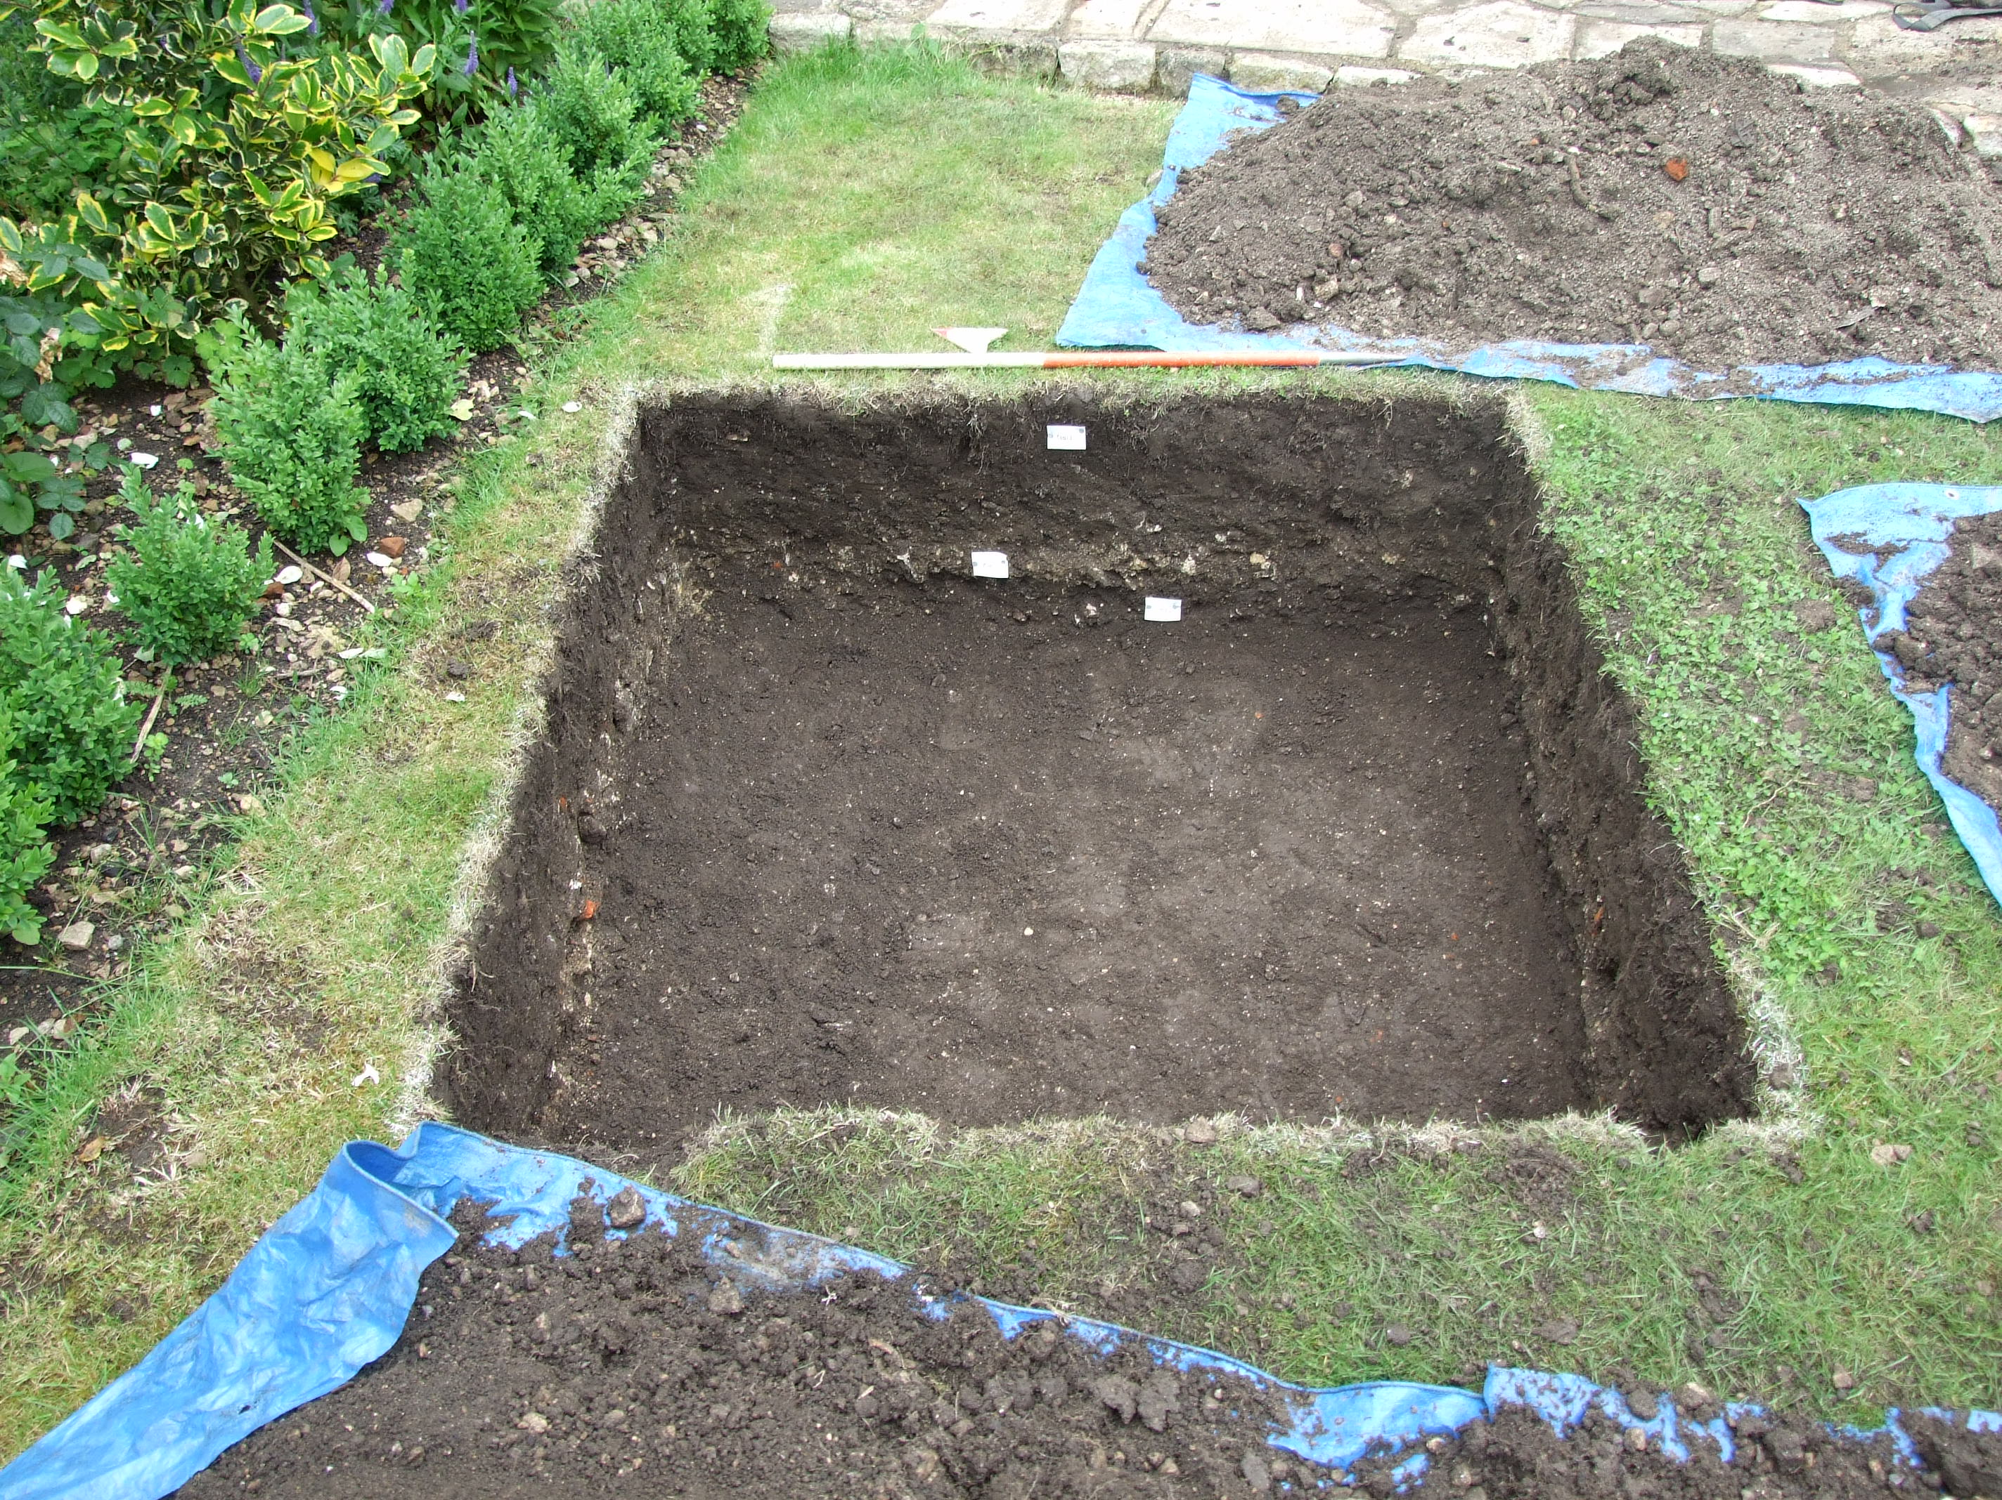

Slide 7
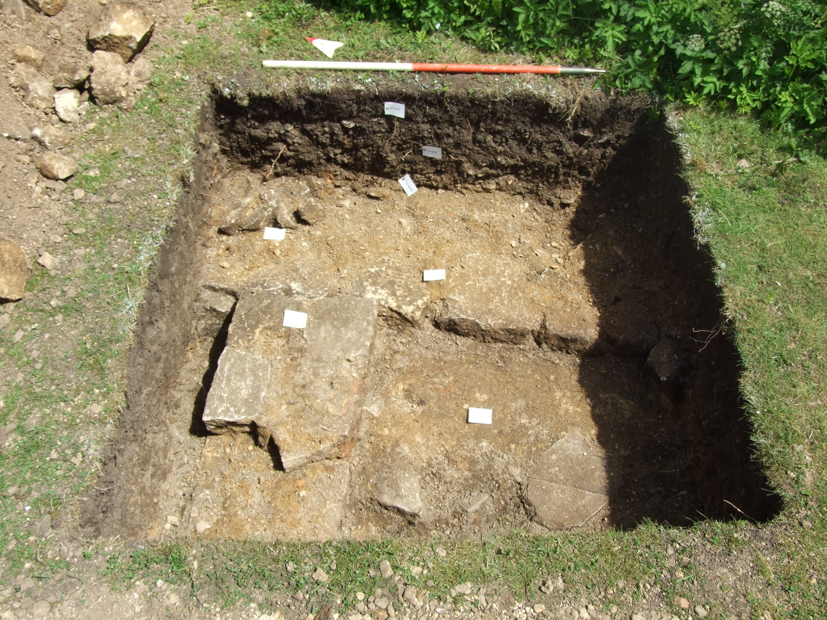

Slide 8
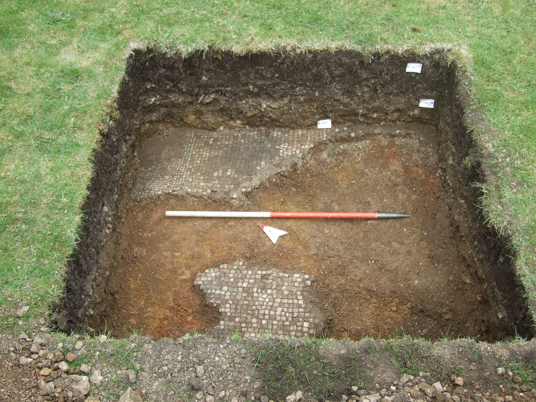

Slide 9
Digging the test pits
AM
Meet up
Remove turf…………………….archaeologist
Dig / metal detect…………….archaeologist / volunteers
PM
Recording……………………….archaeologist
Backfill…………………………..archaeologist
Bathroom facilities? (we promise to remove our digging boots!)
Heavy rain – we’ll dig another day!

Slide 10
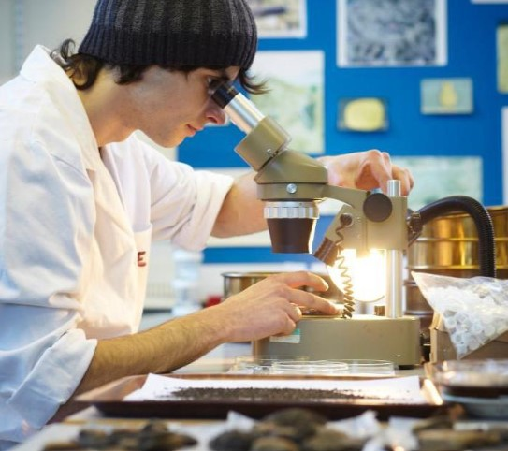
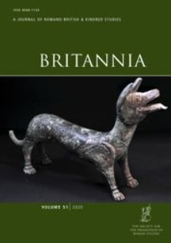
After The Dig?
Specialist analysis
Archaeological synthesis
Full report / publication

Slide 11
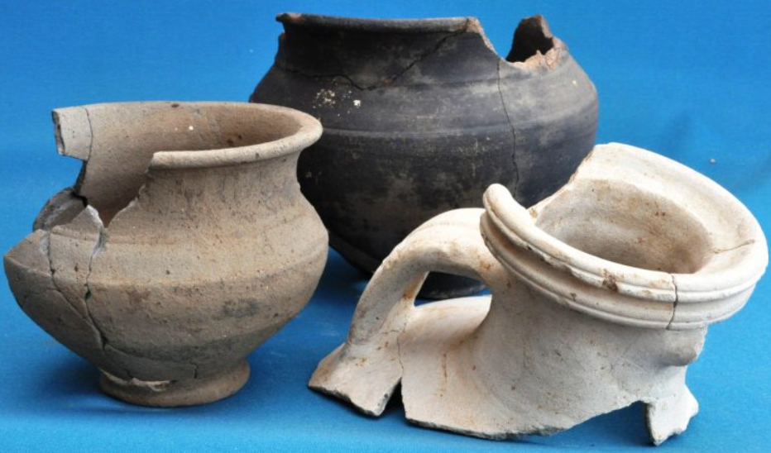
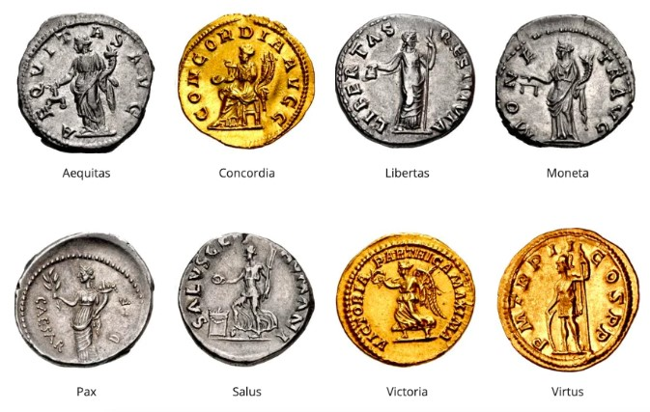
Finds to Wiltshire Museum, Devizes
Treasure Trove….

Slide 12
THE ROMANS IN PURTON PROJECT
facebook: #romans_in_purton

